Slide 1
Self-Pretrainable In-situ Normalizer For Deep Learning Error Function
Speaker: Jyun-Xin Ke
Advisor: Tsung-Chu Huang

Slide 2
Outline
Introduction
Previous Work
Error Function
Online Fine-Tuning Method
Offline Sampling Ranking Method
Experiment for SPINDLE
Experiment for KDE-SPINDLE
Conclusions

Slide 3
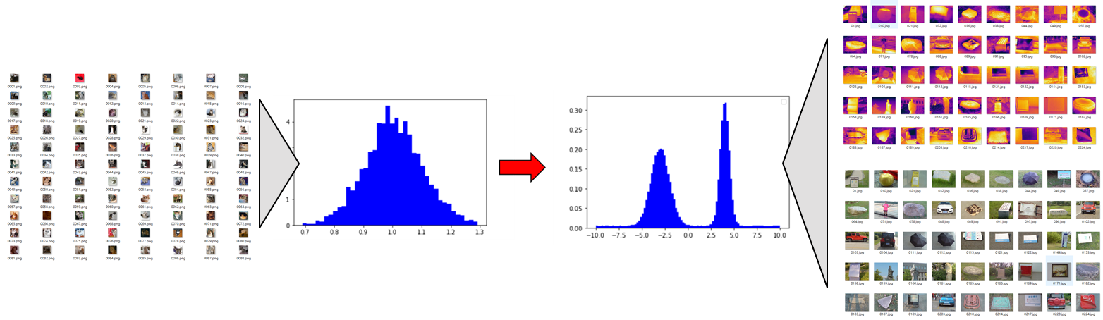
Introduction
Neural networks have become the mathematical model in the field of AI, and have been applied in the consumer electronics.
Since the data come from different datasets, the input probability density Function (pdf) of activation function is no longer normal distribution.

Slide 4
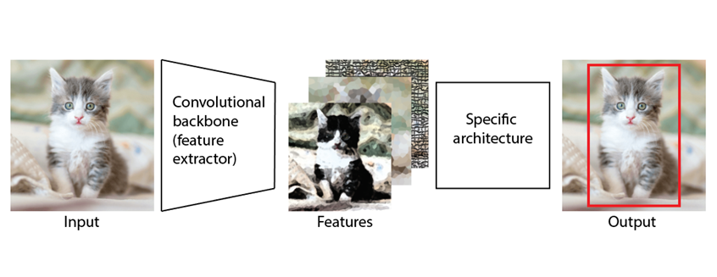
Introduction
With the expansion of information, neural networks have more layers and higher training costs each year.
Backbone neural networks can reduce training time by utilizing pre-trained convolutional networks.
Neck
Head
SPINDLE

Slide 5
Previous Work
Multi-head
Vision Transformer: GELU, softmax
Backbone-Based
Neural Network
Single head
Yolo: LeakyReLU, Mish
Activation function
Non-Backbone-Based
Neural Network
Use PWL Algorithm
Approximate Tanh(x)

Slide 6
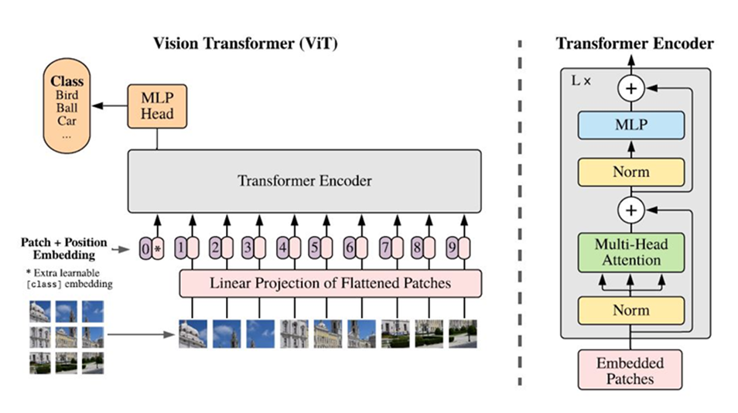
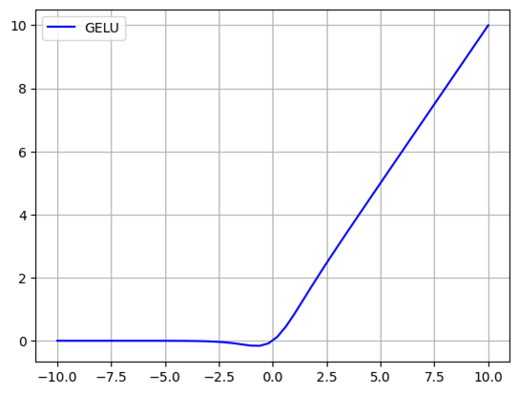
Previous Work
Backbone-Based Neural Network
Multi-head Attention
Multi-head Attention is a module for attention mechanisms which runs through an attention mechanism several times in parallel.
Fig.1 Vision Transformer^{[17]}
Fig.2 GELU

Slide 7
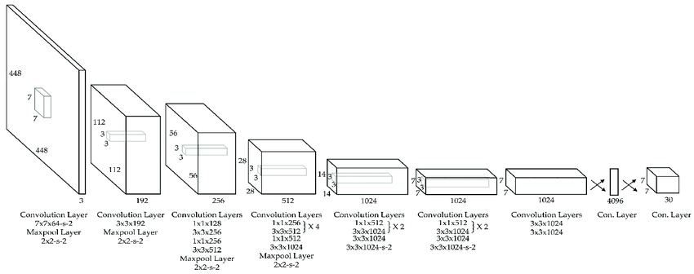
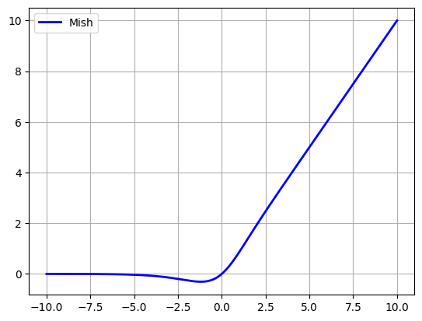
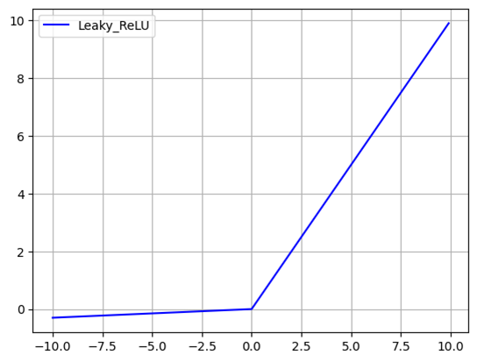
Previous Work
Backbone-Based Neural Network
Single Head Detector
A single head refers to a single set of output units in the network.
These output units are responsible for generating predictions or outputs for a specific task.
Fig.1 Yolo^{[20]} model
Fig.2 Mish & LeakyReLU

Slide 8
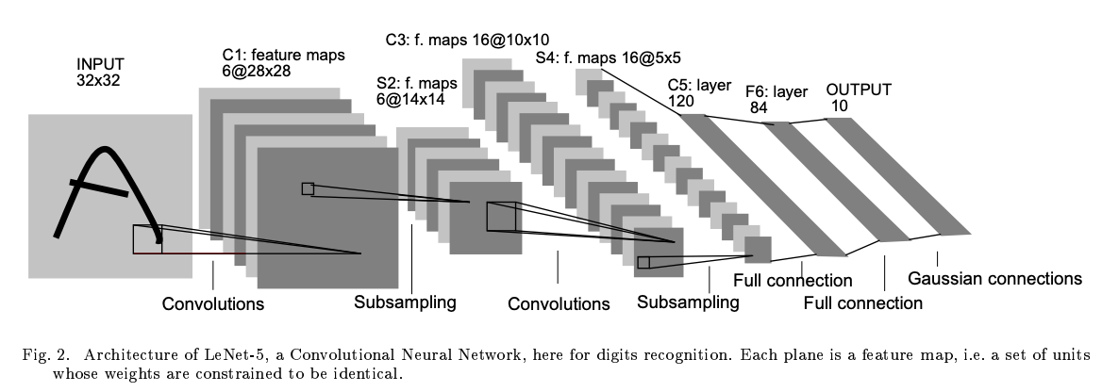
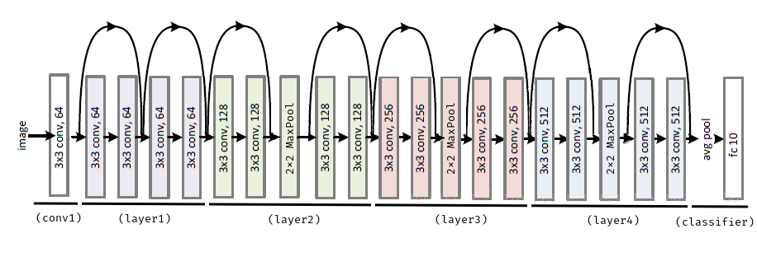
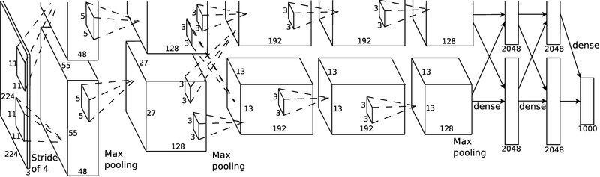
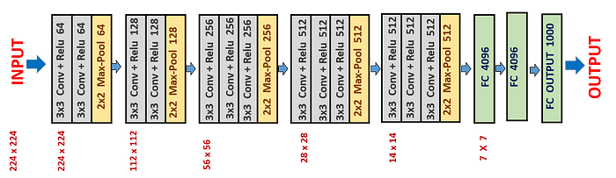
Previous Work
Backbone Classifier
Fig.1 LeNet-5^{[9]} Model
Fig.3 ResNet-18^{[11]} Model
Fig.2 AlexNet^{[10]} Model
Fig.4 VGG-16^{[12]} Model

Slide 9
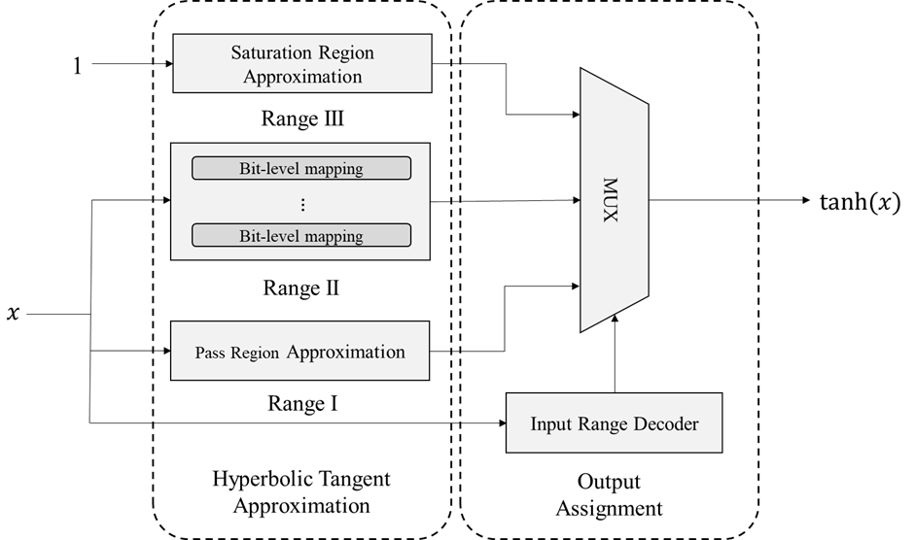
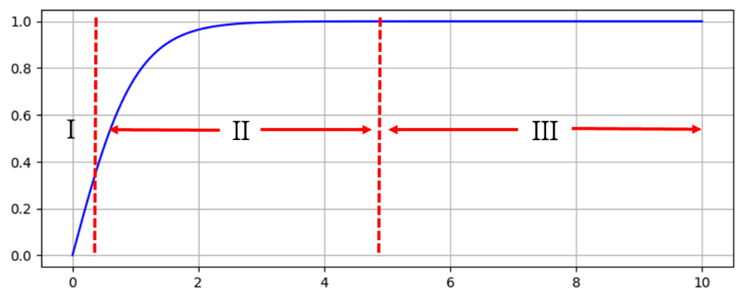
Previous Work
Non-Backbone-Based Neural Network
The piecewise linear function (PWL) is constructed using segments or pieces to calculate different patterns of features.
However, each time a different curve is used, it is necessary to redesign the piecewise function.
Fig.1 PWL tanh function
Fig.2 PWL hardware circuit^{[24]}

Slide 10
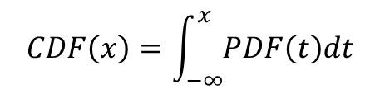
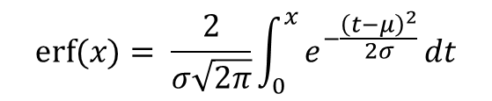
Error Function
What is Error Function?
According to the law of large numbers, the distribution of features tends to approach a normal distribution.
Therefore, the cumulative probability distribution function(CDF) of the activation function will be an error function.
$$erf⁡(x)= \frac{2}{σ\sqrt{2π}}\int_{0}^{x}{e^{−\frac{{\left(t−μ\right)}^{2}}{2σ}}dt}$$
$$CDF\left(x\right)=\int_{−∞}^{x}{PDF\left(t\right)dt}$$

Slide 11
Error Function
What is Error Function?
RGB & NIR dataset

Slide 12
Online Fine-tuning Method
Four kinds of ReLUs
$$ReLU\left(s_{x},s_{y},x\right)=s_{y}∙max⁡(0, s_{x}∙(x−bias))$$
Monotonic increasing function
$$ReLU\left(1,s_{y},x\right)={ℒ\left(s_{y}, x−bias\right)=s}_{y}∙\max\left(0, \left(x−bias\right)\right)$$

Slide 13
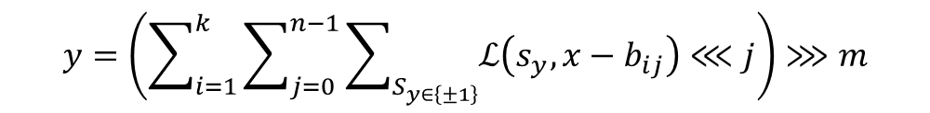
Online Fine-tuning Method
SPINDLE architecture
$$ReLU\left(1,s_{y},x\right)={ℒ\left(s_{y}, x−bias\right)=s}_{y}∙\max\left(0, \left(x−bias\right)\right)$$
Given a 2^{m} slopes
Shifter replace multiplier
$$y=\left(\sum_{i=1}^{k}{\sum_{j=0}^{n−1}{\sum_{S_{y∈\left\{±1\right\}}}{ℒ\left(s_{y}, x−b_{ij}\right)}}}⋘j\right)⋙m$$

Slide 14
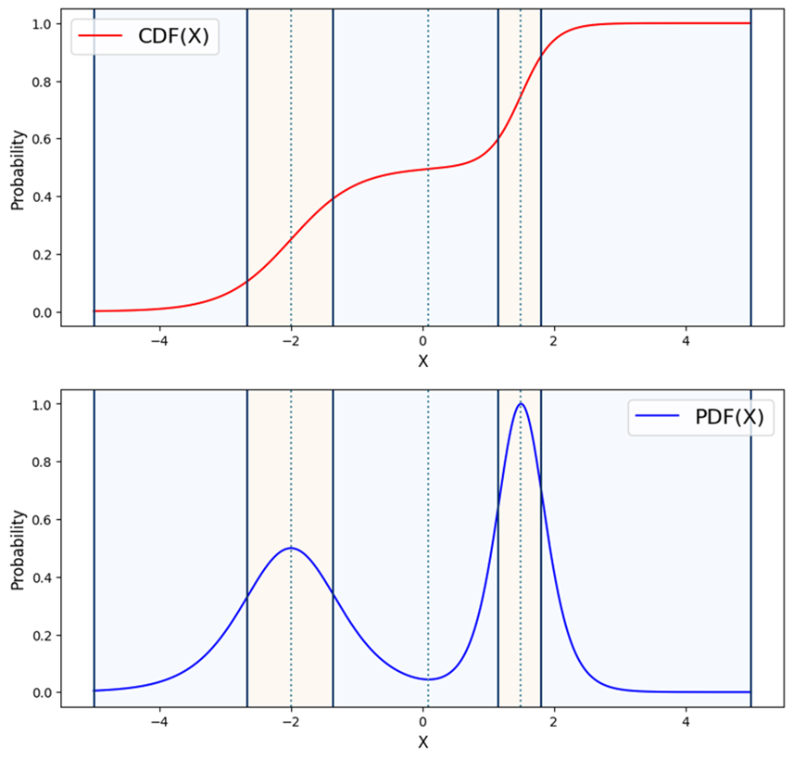
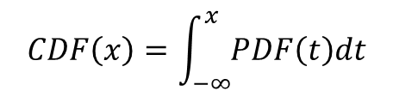
Online Fine-tuning Method
Binary Search LS-PWL
$$CDF\left(x\right)=\int_{−∞}^{x}{PDF\left(t\right)dt}$$

Slide 15
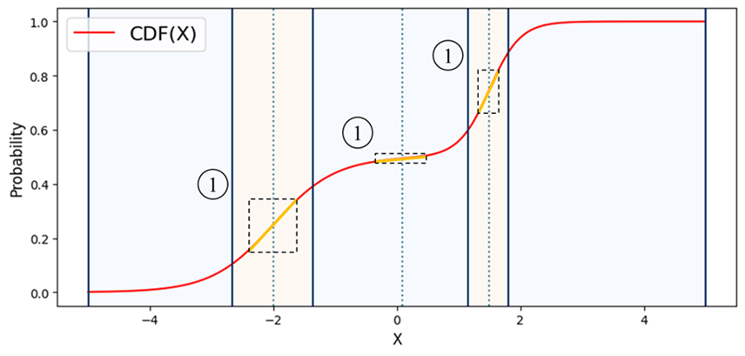
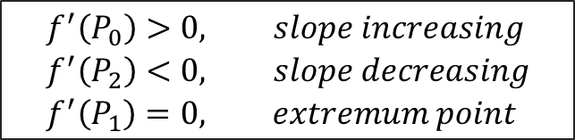
Online Fine-tuning Method
Binary Search Light-Slope Piece-Wise Line
$$\begin{aligned}&f^{′}\left(P_{0}\right)>0, slope increasing \\ &f^{′}\left(P_{2}\right)<0, slope decreasing \\ &f^{′}\left(P_{1}\right)=0, extremum point\end{aligned}$$

Slide 16
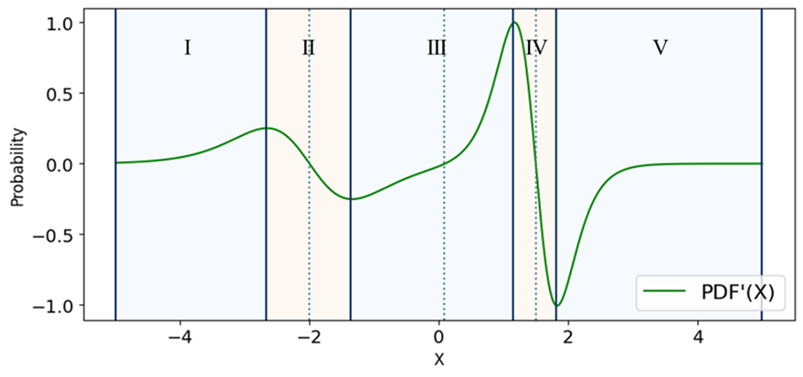
Online Fine-tuning Method
Binary Search Light-Slope Piece-Wise Line

Slide 17
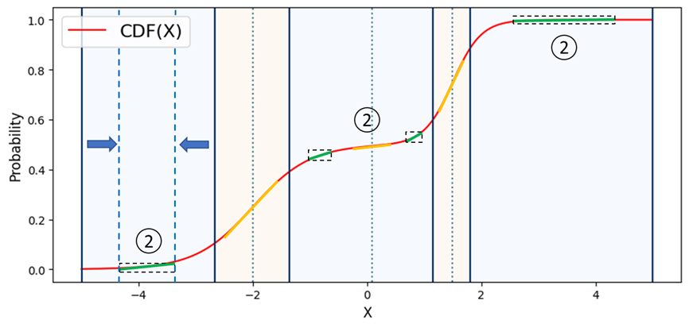
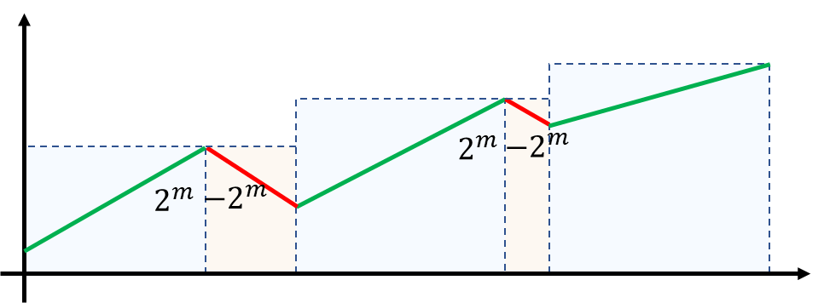
Online Fine-tuning Method
Binary Search Light-Slope Piece-Wise Line

Slide 18
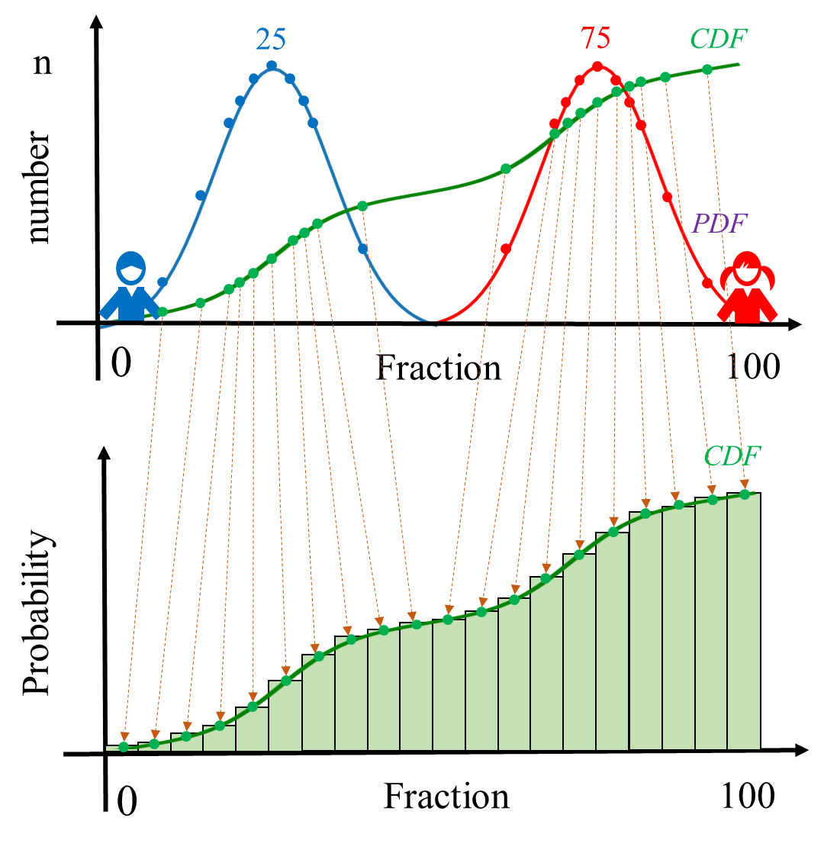
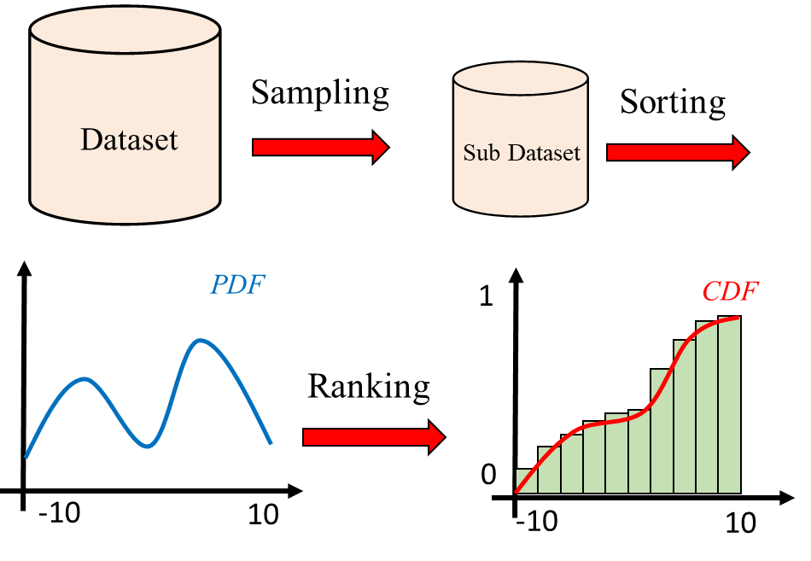
Offline Sampling Ranking Method
Sampling Method
Sampling Ranking Method

Slide 19
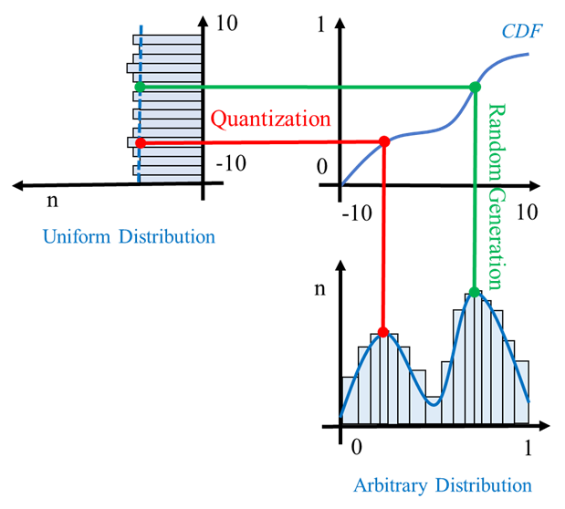
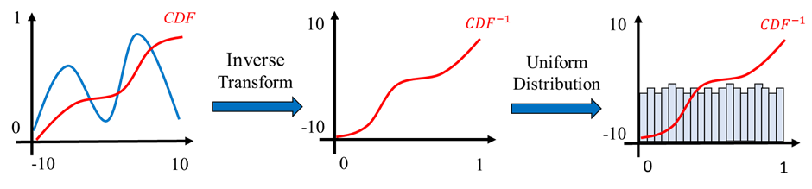


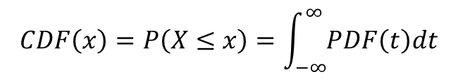
Offline Sampling Ranking Method
Sampling Method
Inverse Transform Sampling
$$CDF\left(x\right)=P\left(X≤x\right)=\int_{−∞}^{∞}{PDF\left(t\right)dt}$$
$$U=CDF\left(X\right)$$
$$X={CDF}^{−1}\left(U\right)$$

Slide 20
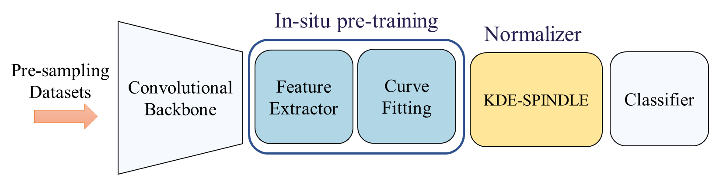
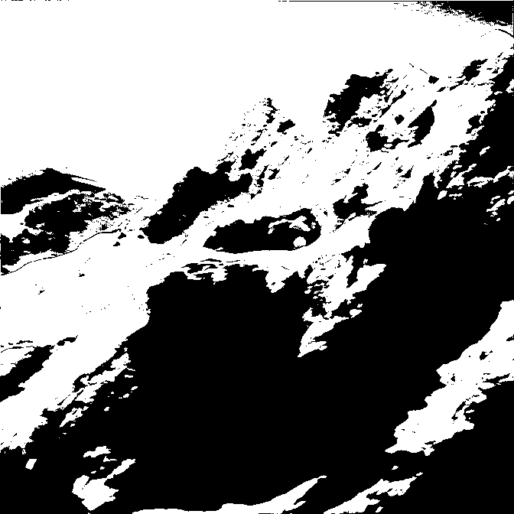
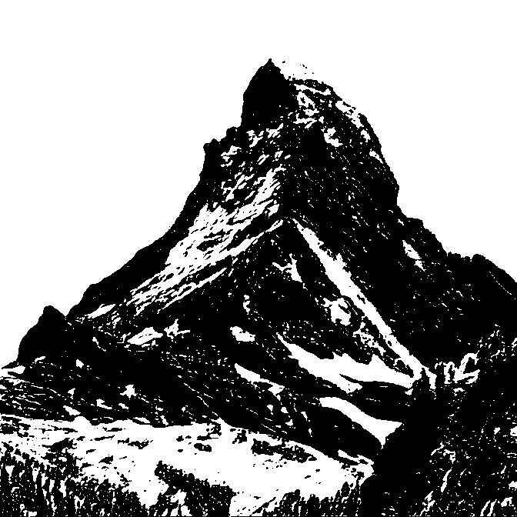
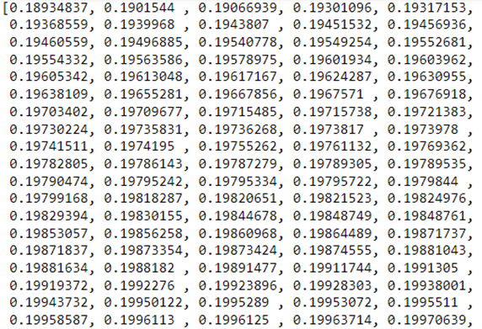
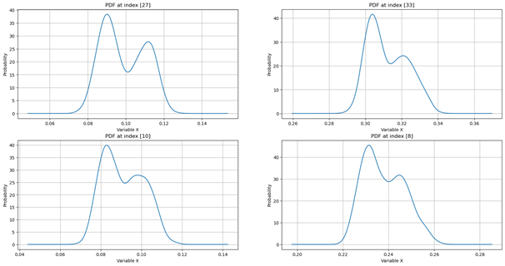
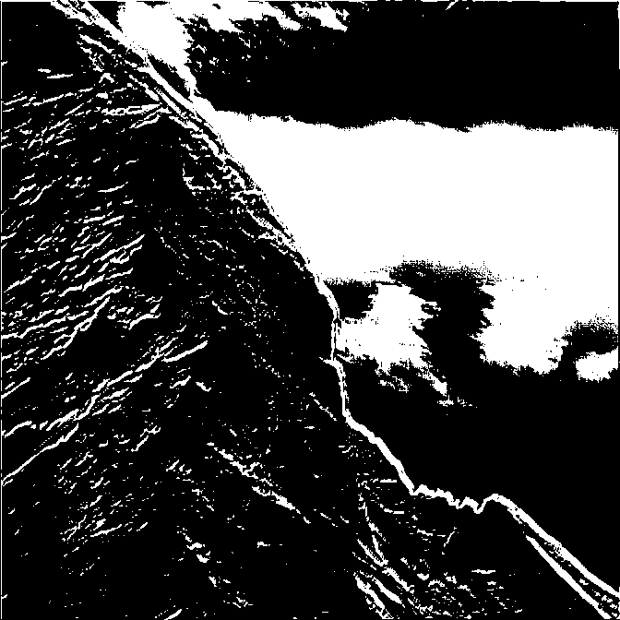
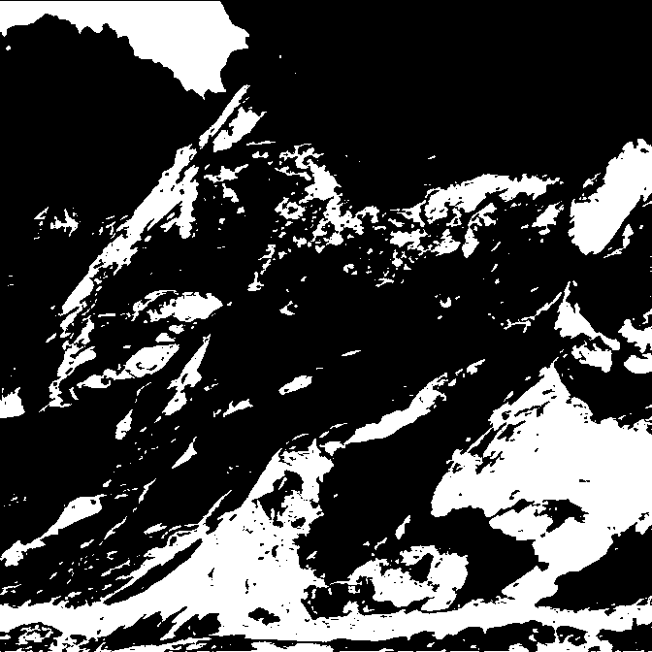
Offline Sampling Ranking Method
Feature extractor
In computer vision, a feature extractor takes an image as input and identifies key visual patterns or characteristics that are useful for subsequent analysis or classification.
1
1
…
…
…
1
1
…
(a) Feature Map
(b) Feature Extraction
(c) Feature Flattening
(d) Feature Distribution Map

Slide 21
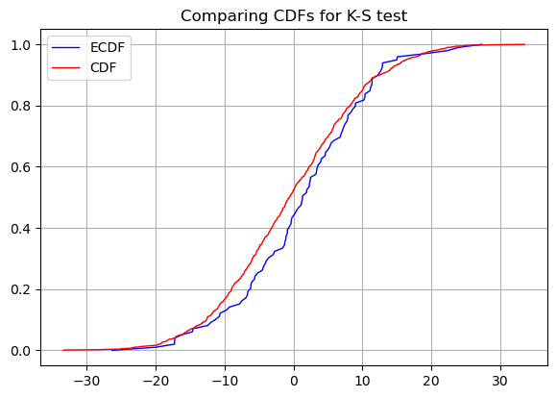
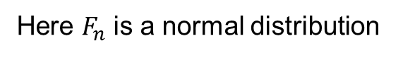
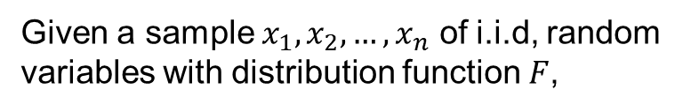
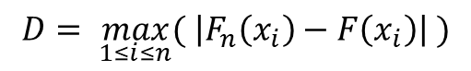
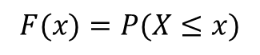
Offline Sampling Ranking Method
Kolmogorov-Smirnov test
The Kolmogorov-Smirnov test is used to decide if a sample comes from a population with a specific distribution.
Given a sample $x_{1},x_{2},…,x_{n}$ of i.i.d, random variables with distribution function $F$,
$$F(x)=P(X≤x)$$
Here $F_{n}$ is a normal distribution
D
$$D= \max_{1≤i≤n}{( \left|F_{n}\left(x_{i}\right)−F\left(x_{i}\right)\right| )}$$

Slide 22
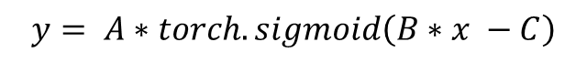
Offline Sampling Ranking Method
KDE-SPINDLE
KDE means Kernel Density Estimation, we use custom sigmoid as the kernel function to replace the ReLU unit.
$$y= A∗torch.sigmoid\left(B∗x −C\right)$$

Slide 23
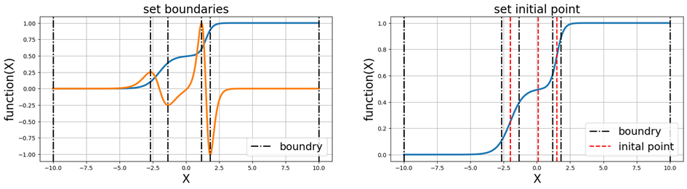
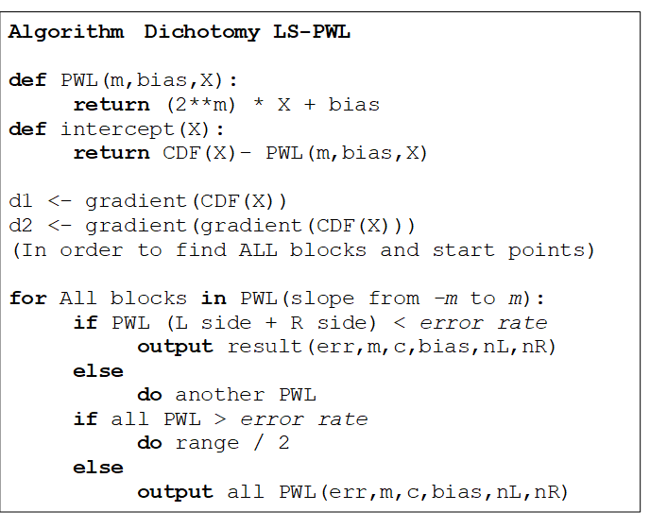
Experiment for SPINDLE
BLS-PWL

Slide 24
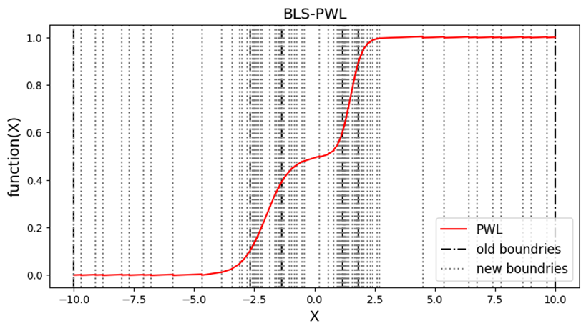
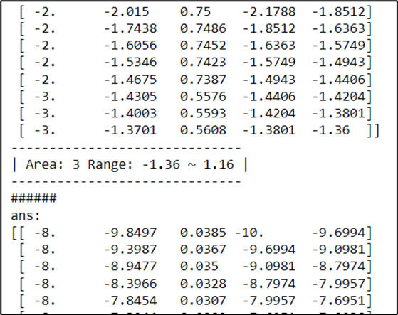
Experiment for SPINDLE
BLS-PWL

Slide 25
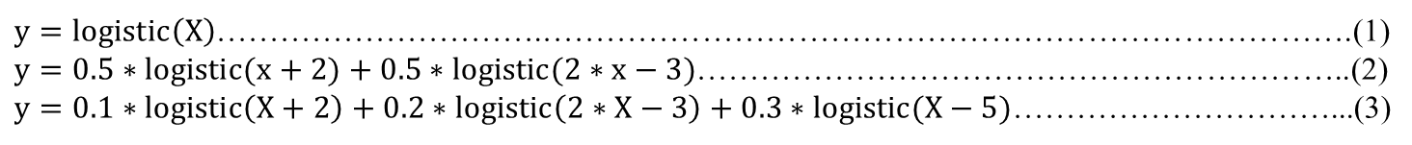
Experiment for SPINDLE
$y=logistic\left(X\right)$………………………….………………………………………………………………….(1)
$y=0.5∗logistic(x+2)+0.5∗logistic(2∗x−3)$……………………………………………………..(2)
$y=0.1∗logistic\left(X+2\right)+0.2∗logistic\left(2∗X−3\right)+0.3∗logistic(X−5)$…………………………...(3)
Table.1 BLS-PWL
BLS-PWL |  | Equation(1) |  |  | Equation(2) |  |  | Equation(3)
PDF Type |  | Unimodal |  |  | Bimodal |  |  | Multimodal
Target error |  | 0.01 | 0.005 | 0.001 | 0.01 | 0.005 | 0.001 | 0.01 | 0.005 | 0.001
Cost | PWL | 23 | 33 | 163 | 17 | 35 | 137 | 19 | 31 | 129
Cost | ReLU | 46 | 66 | 326 | 34 | 70 | 274 | 38 | 62 | 258
Table.2 LS-PWL
LS-PWL[25] |  | Equation(1) |  |  | Equation(2) |  |  | Equation(3)
PDF Type |  | Unimodal |  |  | Bimodal |  |  | Multimodal
Target error |  | 0.01 | 0.005 | 0.001 | 0.01 | 0.005 | 0.001 | 0.01 | 0.005 | 0.001
Cost | PWL | 7 | 11 | 32 | NA | NA | NA | NA | NA | NA

Slide 26
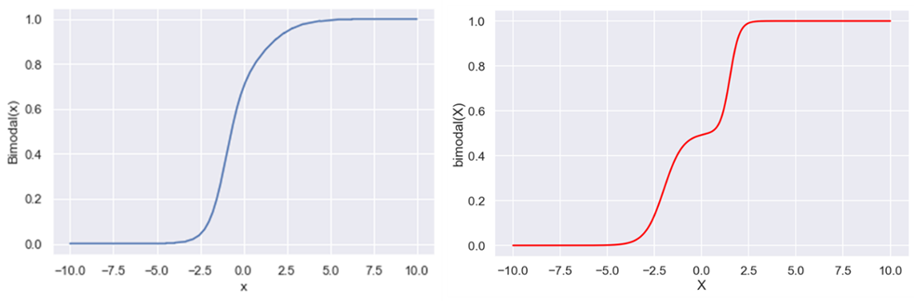
Experiment for SPINDLE
Fig.1 LS-PWL^{[25]} bimodal function
Fig.2 BLS-PWL bimodal function
Table. Compare with pervious work
 | LS-PWL^{[25]} | BLS-PWL
Fine-Tune | No | Yes
Hardware circuit | Yes | Yes
PWL Cost | Low | high
Function | Only Unimodal distribution | Any distribution

Slide 27
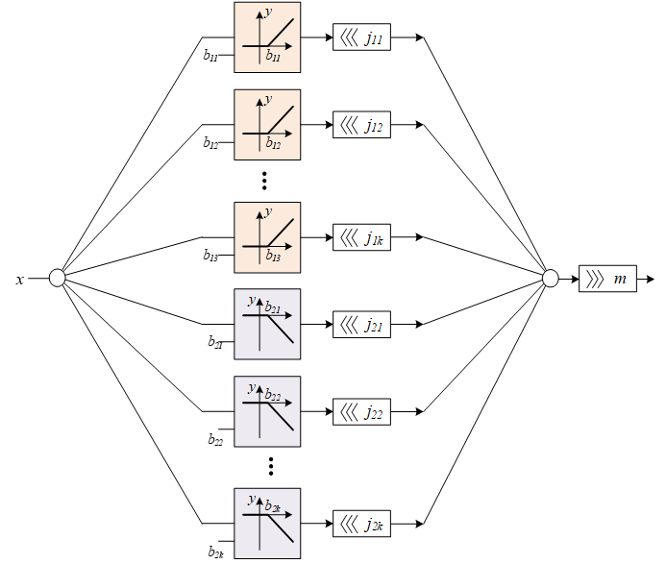
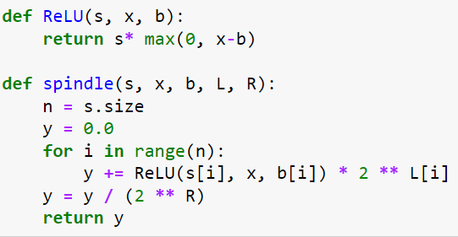
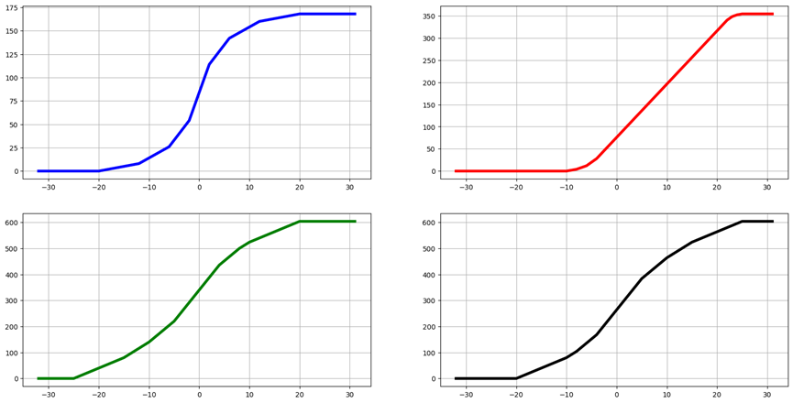
Experiment for SPINDLE
SPINDLE
Fig.1 SPINDLE.ipynb (Python code)
Fig.2 Four kinds of activation (Golden data)

Slide 28

Experiment for SPINDLE
SPINDLE
Testbench
clk
SPINDLE
rst
sign
bias
L
R
x
y
Fig.1 block diagram
Fig.2 timing diagram

Slide 29





Experiment for SPINDLE
SPINDLE
Fig.1 SPINDLE.v (Verilog Code)
Fig.2 Four Output Wave View

Slide 30





Experiment for SPINDLE
Table. CHIP PAT
 | SPINDLE
function | Any kind of activation (Fine-Tune)
stage | Per-sim | Post-sim
Power($mW$) | 4.4151 | 5.4151
Area($μm^{2}$) | 991848.318711 | 997419.837070
Timing($ns$) | 15.24 | 16.13

Slide 31



Experiment for KDE-SPINDLE
Sampling Ranking Method

Slide 32

Experiment for KDE-SPINDLE
Sampling Ranking Method

Slide 33


Experiment for KDE-SPINDLE
Inverse Transform Sampling
Fig.1 Two dataset PDF
Fig.2 Two dataset CDF & difference value

Slide 34


Experiment for KDE-SPINDLE
Three kinds of backbone neural network
Fig.1 nirscene1^{[2]} dataset
Fig.2 non-normal distribution feature map (VGG-16)

Slide 35

Experiment for KDE-SPINDLE
Table.1 Feature Extraction Parameters
Model | AlexNet[10] | ResNet-18[11] | VGG-16[12]
Dataset | nirscene1[2] | nirscene1[2] | nirscene1[2]
Kernel Unit | $$y= A∗torch.sigmoid(B∗x −C)$$
Kernel Number | 2 | 2 | 2
Variable Value | [0.2, 522.6, -26.6] [0.8, 788.3, -41.5] | [0.3, 79, -33.1] [0.7, 84.8, -32.7] | [0.8, 36.8, 2.3] [0.2, 51.7, 5.9]
Table.2 Compare with Test Accuracy
Dataset |  | nirscene1[2]
Model |  | AlexNet[10] |  | ResNet-18[11] |  | VGG-16[12]
 |  | Orig. | Ours | Orig. | Ours | Orig. | Ours
Input | (C,H,W) | (3,256,256) |  | (3,224,224) |  | (3,224,224)
Batch size |  | 8 |  | 8 |  | 8
Train / Test num. |  | 612 / 342 |  | 612 / 342 |  | 612 / 342
Layer |  | 27 |  | 73 |  | 40
Learning Rate |  | 1e-5 | 1e-5 | 1e-4 | 5e-5 | 1e-5 | 1e-5
Epoch |  | 500 |  | 100 |  | 100
Total Params |  | 11.24 M |  | 44.69M |  | 119.61 M
Params size | (MB) | 182.25 |  | 106.27 |  | 675.7
Accuracy | (%) | 38.89 | 42.4 | 41.8 | 42.4 | 66.67 | 71.92

Slide 36

Experiment for KDE-SPINDLE
Three kinds of backbone neural network

Slide 37


Experiment for KDE-SPINDLE
Three kinds of custom datasets
Fig.1 PolyMNIST^{[27]} dataset
Fig.2 non-normal distribution feature map (M0-dataset)

Slide 38

Experiment for KDE-SPINDLE
Table.1 Feature Extraction Parameters
Model | LeNet-5[9]
Dataset | M0-MNIST | M1-MNIST | M2-MNIST
Background | Candy | Fire | Sea
Kernel Unit | $$y= A∗torch.sigmoid(B∗x −C)$$
Kernel Number | 2 | 3 | 2
Variable Value | [0.5, 522.6, -26.6] [0.8, 788.3, -41.5] | [0.2, 173.1, -17.9] [0.5, 138, -12.9] [0.3 188.5 -15.9] | [0.5, 185.3, -23.3] [0.5, 121, -16.2]
Table.2 Compare with Test Accuracy
Kind |  | Base |  | Backbone |  |  | Ours
Activation |  | ReLU [13] | Sigmoid [15] | L-ReLU [19] | Mish [19] | GeLU [21] | SPINDLE
M0 | Accuracy | 97.24 | 97.09 | 97.22 | 97.14 | 96.99 | 97.25
 | Inaccuracy | 2.76 | 2.91 | 2.78 | 2.86 | 3.01 | 2.75
M1 | Accuracy | 98.65 | 98.71 | 98.7 | 98.75 | 98.61 | 98.79
 | Inaccuracy | 1.35 | 1.29 | 1.3 | 1.25 | 1.39 | 1.21
M2 | Accuracy | 98.89 | 98.73 | 98.78 | 98.82 | 98.83 | 98.85
 | Inaccuracy | 1.11 | 1.27 | 1.22 | 1.18 | 1.17 | 1.15

Slide 39


Experiment for KDE-SPINDLE

Slide 40

Experiment for KDE-SPINDLE
Fig.1 Self Pre-trainable In-situ Normalizer for Deep Learning Error function
Table.1 Ranking of the six activation functions
Kind |  | Base |  | Backbone |  |  | Ours
Activation |  | ReLU [13] | Sigmoid [15] | L-ReLU [19] | Mish [19] | GeLU [21] | SPINDLE
M0 | Rank | II | V | III | IV | VI | I
M1 | Rank | V | III | IV | II | VI | I
M2 | Rank | I | VI | V | IV | III | II
Total Rank |  | II | V | IV | III | VI | I

Slide 41
Conclusions
This paper is to improve the dataset with non-normal distributions. Basic activation functions are unable to achieve accurate normalization.
This design must be applicable to the backbone network.
In Online SPINDLE, we propose BLS-PWL algorithm that can generate initial points and boundary , and introduce a fine-tuning feature.
In Offline KDE-SPINDLE, we implemented an in-situ design that allows us to change the shape of the activation function through pre-sampling.
We propose two methods to demonstrate the quantization characteristics of the sampled dataset.
Our approach exhibits higher accuracy compared to various backbone networks and existing activation functions.

Slide 42
Thanks for your attention.

